Slide 1
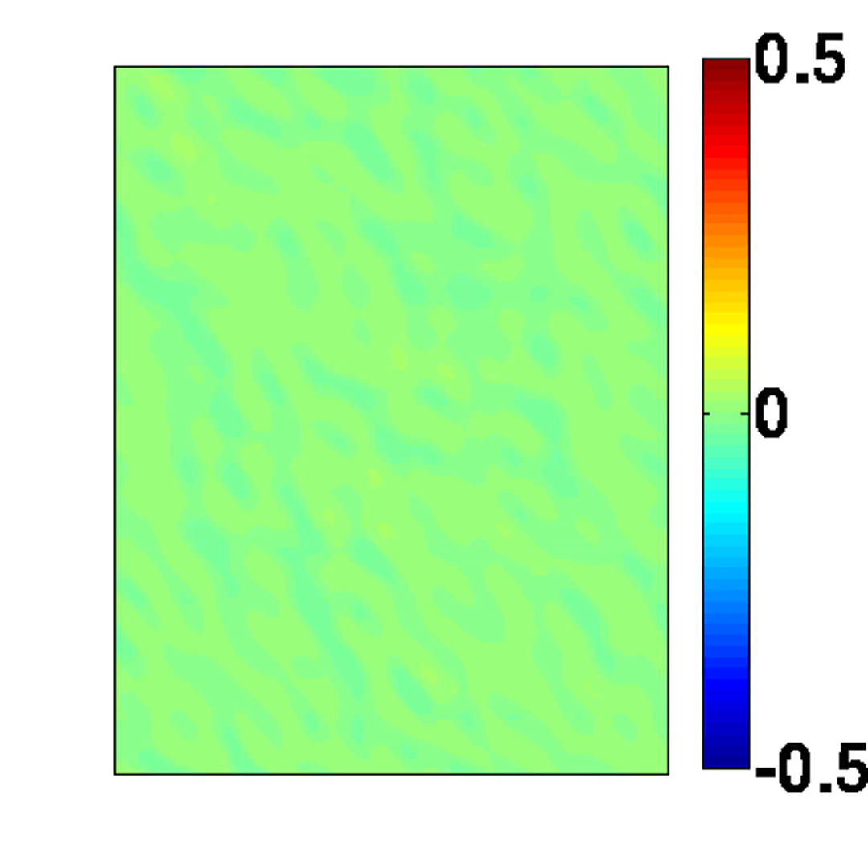

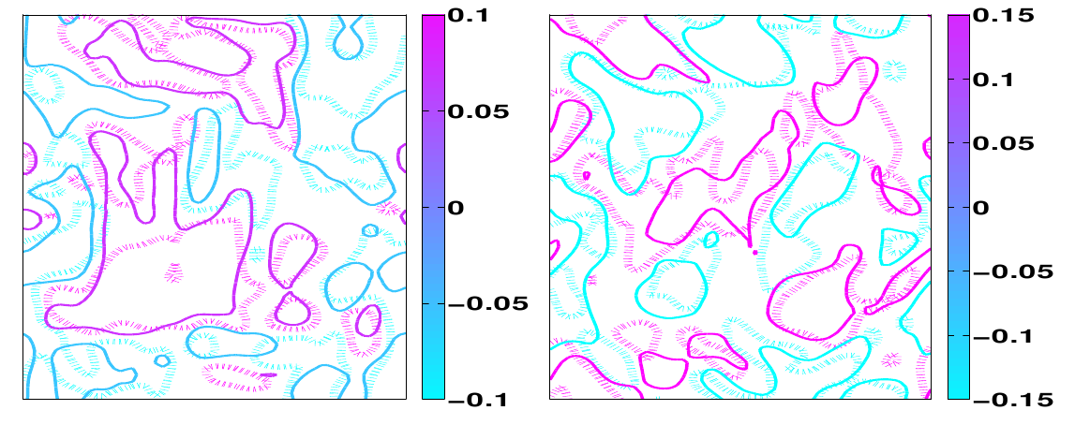
Some plots using MATLAB
Newtonian Fluid
Oldroyd-B Fluid
Visualization of the fluid flows (click on the pictures to see the movie!)
Shear Direction
Normal Direction
Stress in both shear and normal directions for Oldroyd-B fluid
You may find some of my MATLAB codes at https://github.com/Tornado128/MATLAB

